Slide 1
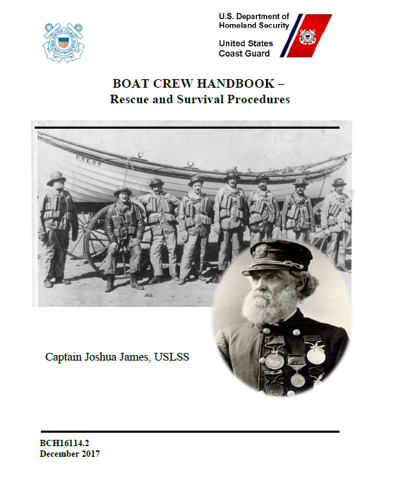
Finding the Material for Boat CREW Qualification
Prepared by WJ Bell
SO-OP Division 9, D1NR
11 March 2021

Slide 2
The References needed for surface operations can be found in the member zone of the Response Directorate’s website on the National Auxiliary web portal.
The link below will take you directly to the exact location.
http://wow.uscgaux.info/content.php?unit=R-DEPT&category=program-operations

Slide 3
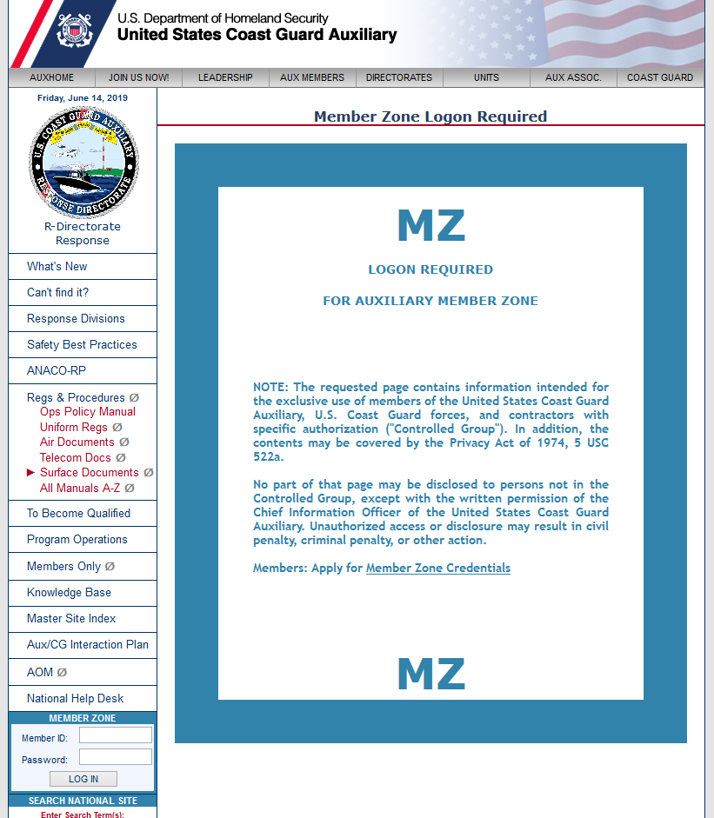
Sign in here using your Member Zone ID & Password

Slide 4
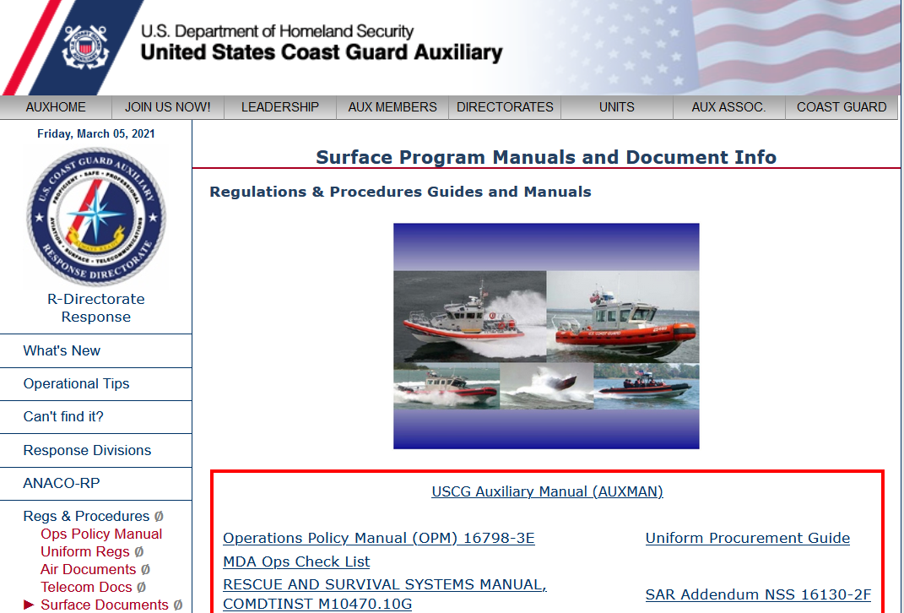
Now you can see the entire collection of available Surface documents

Slide 5
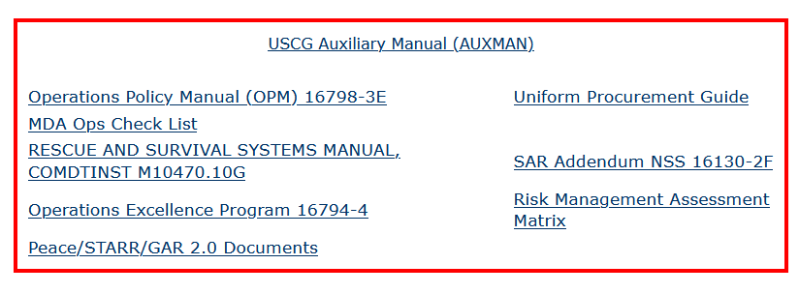
You should download each of the documents outlined in green and save them locally.

Slide 6
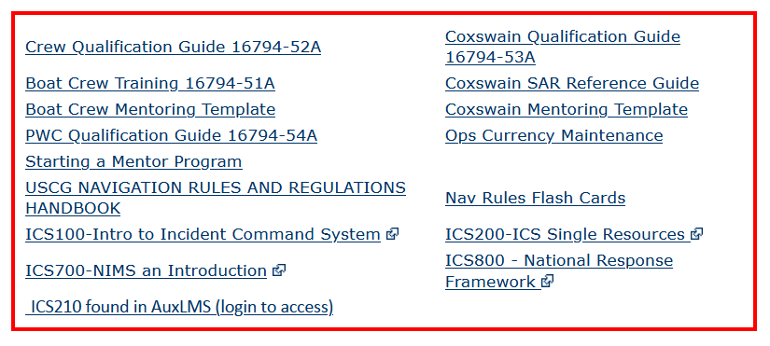
You should download each of the documents outlined in green and save them locally.
It is essential that you have a printed copy of the Crew Qualification Guide.
It would be very helpful if you also print out the boat crew mentoring template

Slide 7
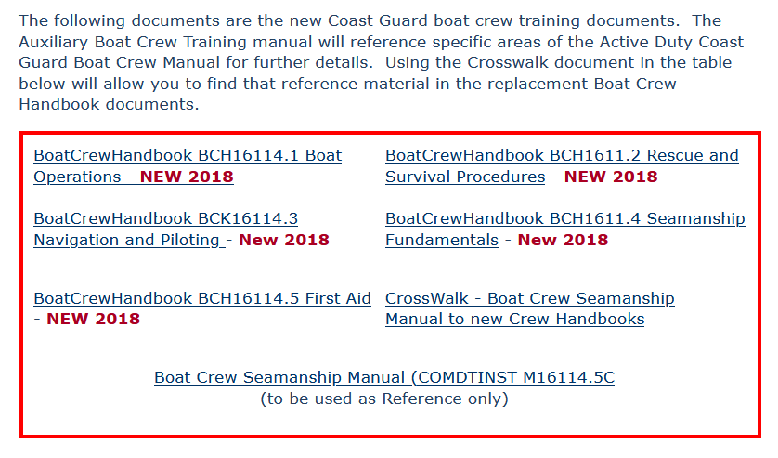
You should download each of the documents outlined in green and save them locally.
It would be very helpful if you print out the Crosswalk – Boat Crew Seamanship Manual & Handbooks.

Slide 8
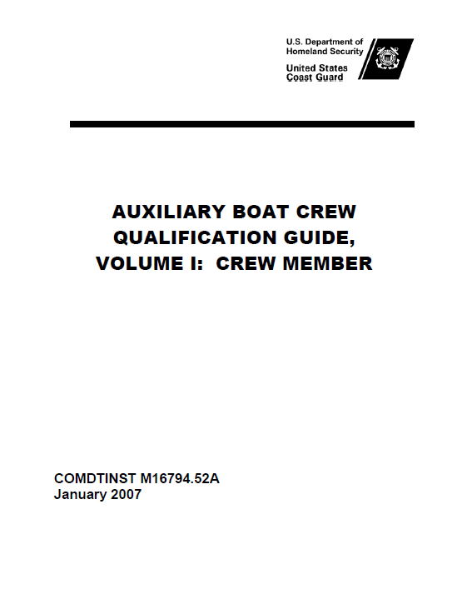
How it Works - Overview
Lists Tasks
Study references
Conditions (ex. ashore, Dockside, U/W)
Standard of Performance
Performance Criteria

Slide 9
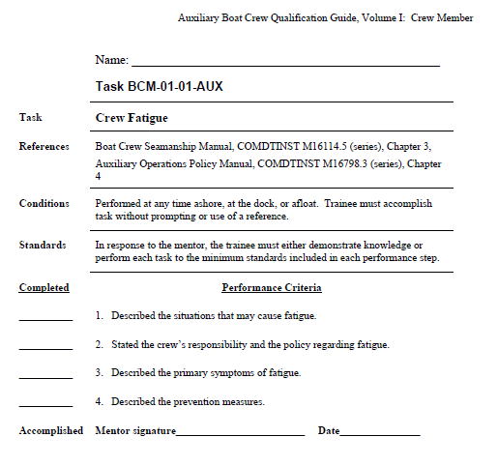
How it Works - Overview
Your Name Goes Here
Very Important Step !
Your Name goes here in Ink
Task Number
Task Name
What you need to Read & Understand
Where and How
Performance Standard
ABM
ABM
ABM
What needs to be
accomplished
ABM
AB Mentor dd MMM YY
Task Complete !

Slide 10
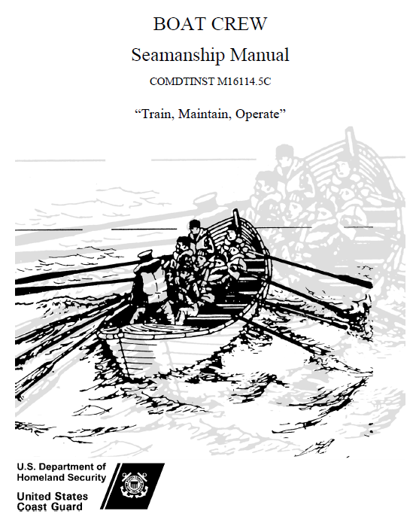
Boat Crew Seamanship Manual COMDTINST M16114.5 (series),
888 pages
Published in 2003
Cancelled 13 DEC 2017
CANCELLED

Slide 11
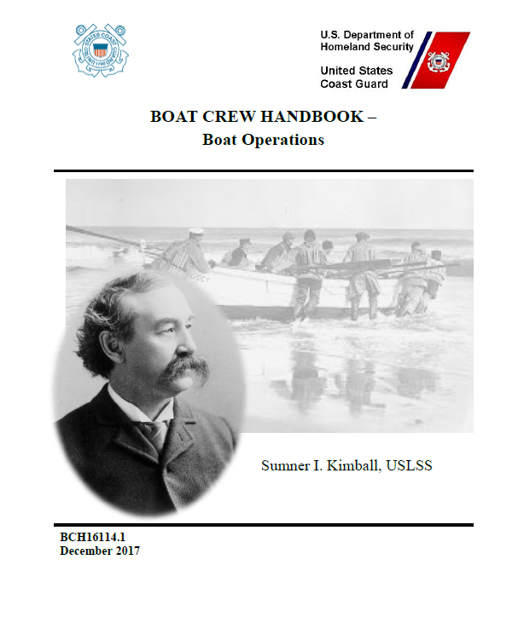
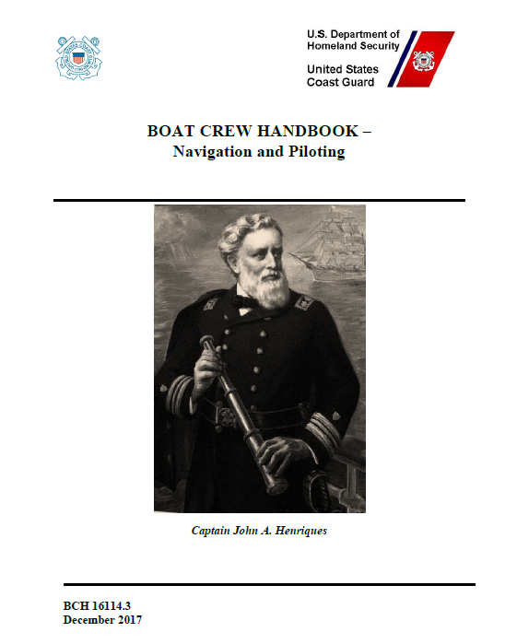
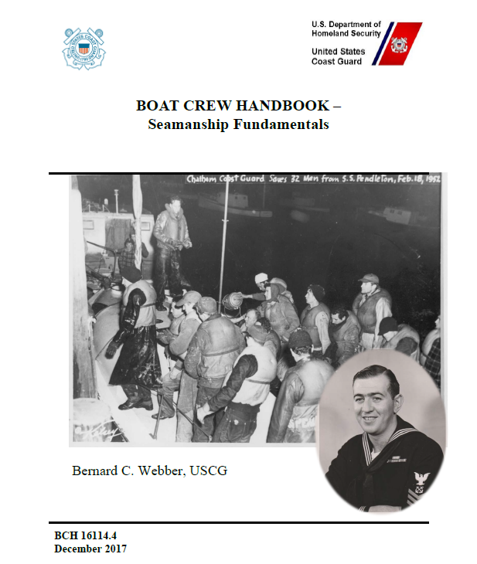
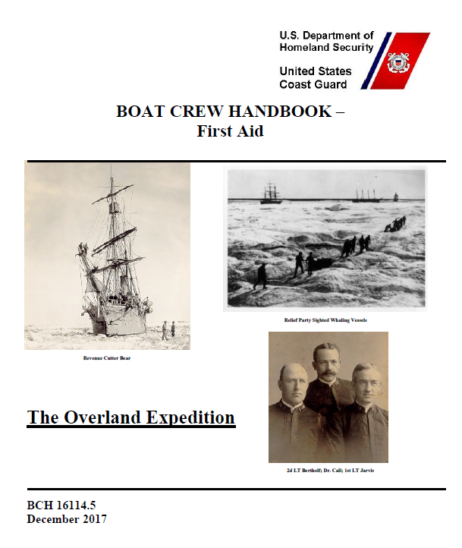
It would be very helpful if you print out the Crosswalk – Boat Crew Seamanship Manual & Handbooks.
About 1100 pages

Slide 12
Good News
You are NOT expected to read
every page of every Reference !
It is NOT even a good idea to try!

Slide 13
Good News
You are ARE expected to Read &
Understand the pages that relate to each task !

Slide 14
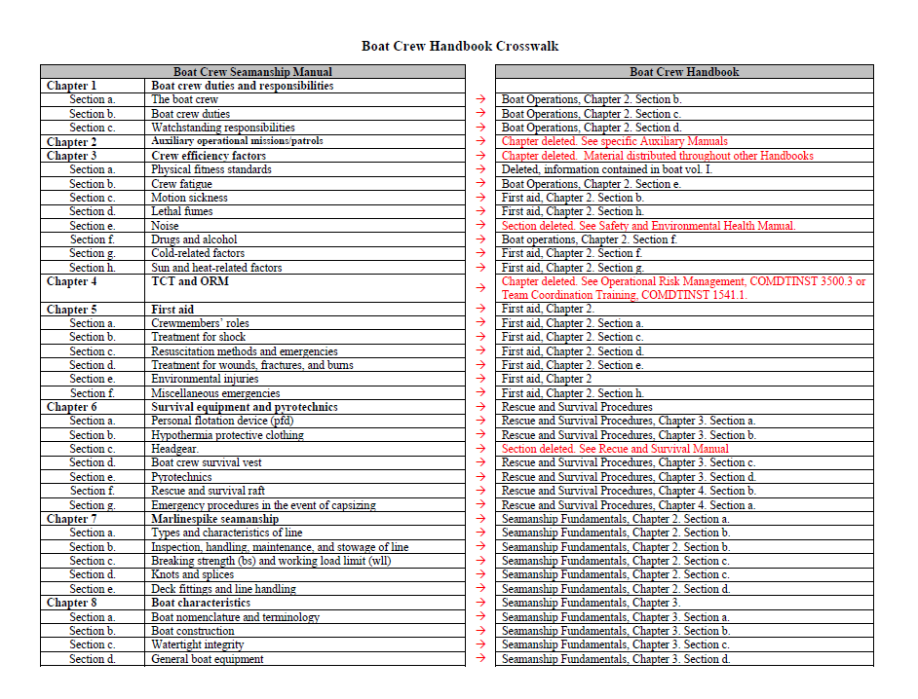
It would be very helpful if you print out the Crosswalk – Boat Crew Seamanship Manual & Handbooks.

Slide 15
Let’s go thru an example

Slide 16
Find the Reading Example
Your Name goes here in Ink
What you need to Read & Understand

Slide 20
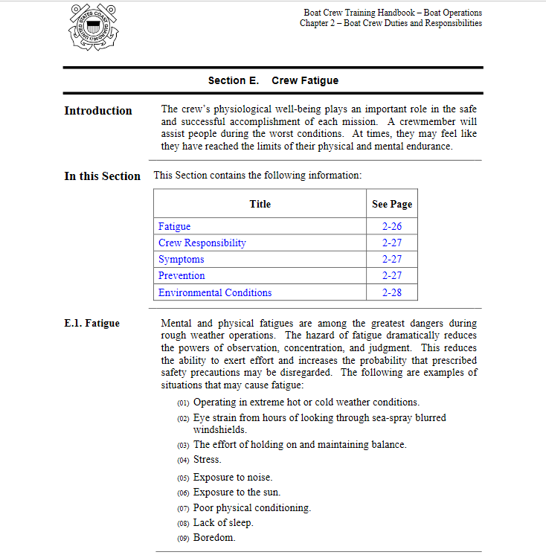

Slide 21
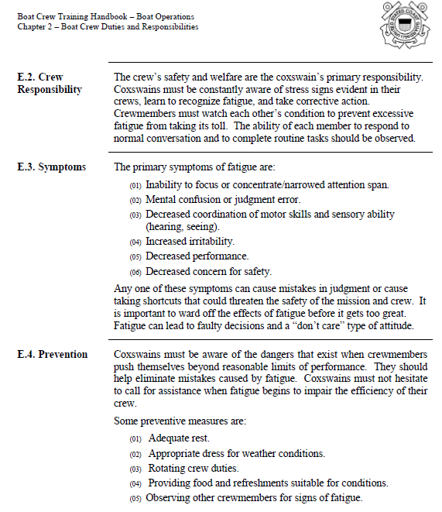

Slide 22
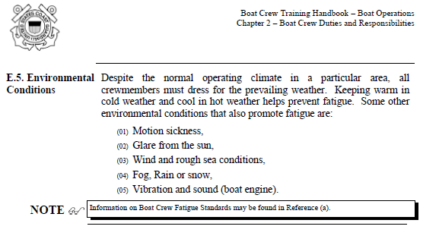
Are we done with this Task ?

Slide 23
Find the Reading Example
Your Name goes here in Ink
What you need to Read & Understand

Slide 24


Slide 25
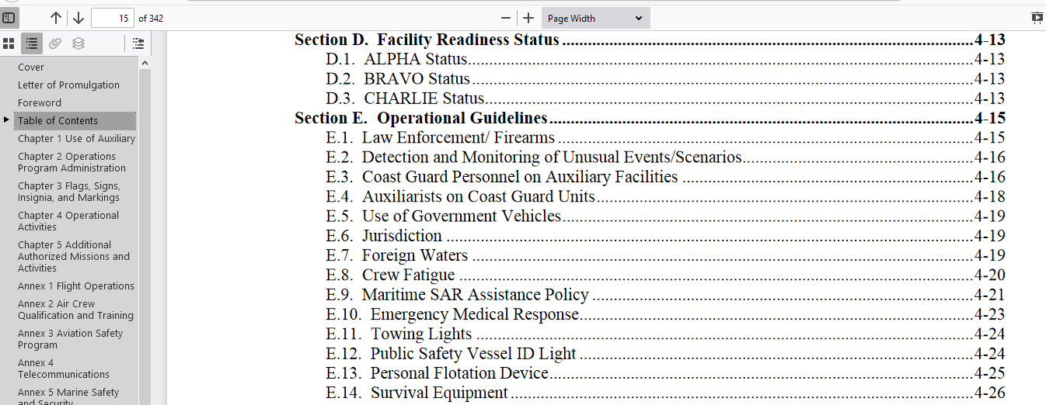
Table of Contents

Slide 26
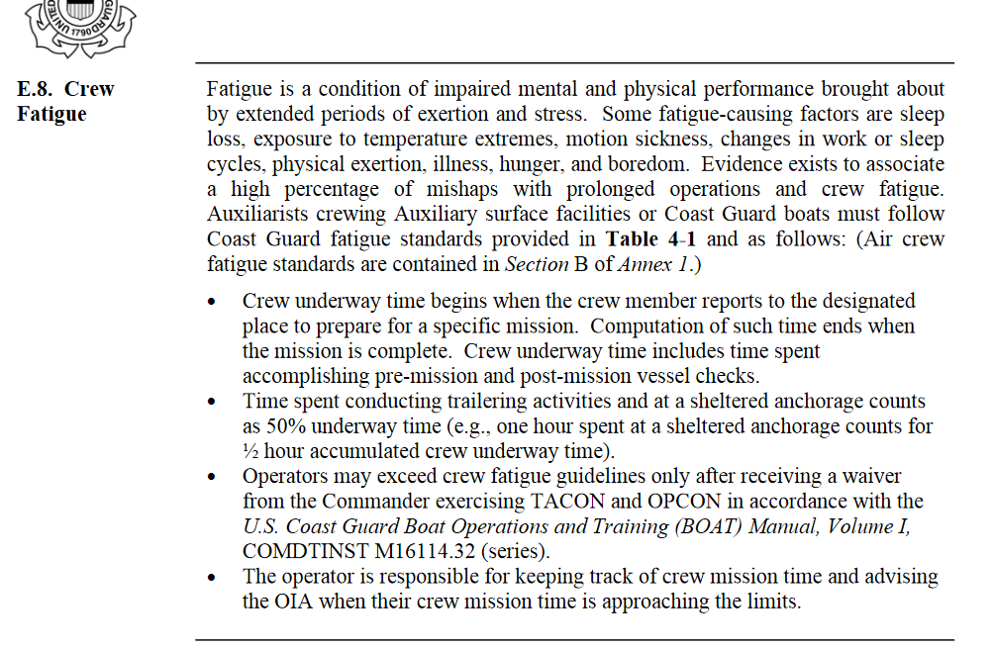

Slide 27
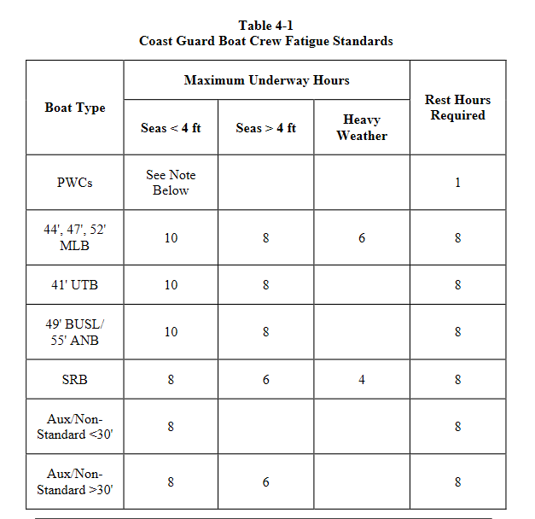

Slide 28
How many pages are you responsible for in the Crew Fatigue Task BCM-01-01-AUX ?
Only 4 Pages !
Is there a lot of information in those few pages ?

Slide 29
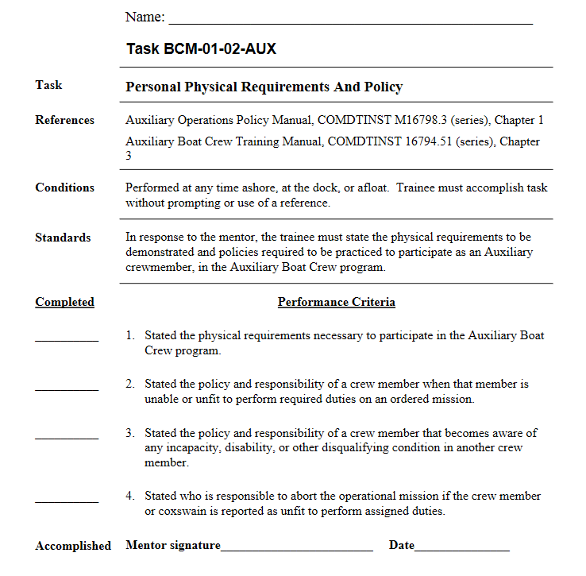

Slide 30
What Exactly are the Tasks ?

Slide 31
Crew Tasks
Crew Efficiency Factors & Team Coordination
BCM-01-01-AUX Crew Fatigue
BCM-01-02-AUX Personal Physical Requirements & Policy
BCM-01-03-AUX Team Coordination Training
BCM-01-04-AUX Complete The Incident Command System (ICS) Courses

Slide 32
Crew Tasks
First Aid And Survival
BCM-02-01-AUX Crew First Aid Responsibility
BCM-02-02-AUX Sun And Heat Related Factors
BCM-02-03-AUX State Symptoms & Treatment For Shock
BCM-02-04-AUX State The Symptoms And Treatment For Anaphylactic Shock (Allergic Rx)
BCM-02-05-AUX Demonstrate Direct Pressure, Pressure Points And Tourniquet Method … Bleeding

Slide 33
Crew Tasks
First Aid And Survival
BCM-02-06-AUX State Signs & Treatment For Burns
BCM-02-07-AUX State The Symptoms And Treatment For Hypothermia
BCM-02-08-AUX Type III PFD, Anti-Exposure Coverall Or Dry Suit Swim
BCM-02-09-AUX Identify Boat Crew Survival Equip.
BCM-02-10-AUX Use Emergency Signaling Mirror

Slide 34
Crew Tasks
First Aid And Survival
BCM-02-11-AUX Describe The Use Of Hand Held Distress Flares
BCM-02-12-AUX Describe The Use Of Aerial Flares
BCM-02-13-AUX Operate Personal Marker Light (PML) or Strobe Light
BCM-02-14-AUX State Survival Procedures In Event The Boat Capsizes Or Swamps

Slide 35
Crew Tasks
Marlinespike Seamanship & Boat Nomenclature
BCM-03-01-AUX Identify The Different Parts Of A Line & Hitches Used In Line Handling
BCM-03-02-AUX Tie Various Knots, Hitches & Bends
BCM-03-03-AUX Secure Lines To Cleats, Bitts & Posts
BCM-03-04-AUX Assist The Coxswain With A Pre-Underway Check-Off Aboard An Auxiliary Facility

Slide 36
Crew Tasks
Boat Handling
BCM-04-01-AUX Assist In Anchoring The Boat
BCM-04-02-AUX Assist In Weighing The Boat’s Anchor
BCM-04-03-AUX Identify Common Navigation Lights Displayed By Ships & Boats
BCM-04-04-AUX Identify Common Sound Signals Used By Ships & Boats
BCM-04-05-AUX Identify & Describe Accepted Maritime Distress Signals

Slide 37
Crew Tasks
Boat Handling
BCM-04-06-AUX Stand A Lookout Watch
BCM-04-07-AUX Act As A Helmsman & Steer A Compass Course
BCM-04-08-AUX Cast Off And Stow Lines & Fenders
BCM-04-09-AUX Prepare For, Moor & Secure The Boat To A Dock

Slide 38
Crew Tasks
Communications
BCM-05-01-AUX Operate A VHF-FM Radiotelephone
BCM-05-02-AUX Use The VHF-FM Radiotelephone To Give A Position Or Operations Normal Report

Slide 39
Crew Tasks
Navigation
BCM-06-01 AUX Identify The Basic Parts, Symbols & Abbreviations Found On A Nautical Chart
BCM-06-02 AUX Identify Common Aids To Navigation Used In Small Boat Piloting
BCM-06-03 AUX Identify Local Landmarks Used In Piloting On A Nautical Chart
BCM-06-04 AUX Plot Position Using Lat / Lon

Slide 40
Crew Tasks
Navigation
BCM-06-05 AUX Plot A Magnetic Course On A Nautical Chart
BCM-06-06 AUX Measure Distance On A Chart
BCM-06-07 AUX Compute Time, Speed & Distance
BCM-06-08 AUX Determine The Depth Of Water Using A Fathometer And/Or A Sounding Pole

Slide 41
Crew Tasks
Mission Oriented Operations
BCM-07-01-AUX Participate In A Man Overboard Evolution As A Pointer
BCM-07-02-AUX Participate In A Man Overboard Evolution As A Recovery/Pick Up Man
BCM-07-03-AUX Bend A Heaving Line To A Bridle & Pass The Heaving Line To Another Boat

Slide 42
Crew Tasks
Mission Oriented Operations
BCM-07-04-AUX Pass A Towline (Bridle) To Another Boat & Take In Stern Tow
BCM-07-05-AUX Stand A Towing Watch
BCM-07-06-AUX Connect A Towline To A Trailer Eye Bolt Using A Shackle Or Kicker/Skiff Hook
BCM-07-07-AUX Take A Boat In Alongside Tow

Slide 43
Crew Tasks
Mission Oriented Operations
BCM-07-08-AUX Moor A Towed Vessel
BCM-07-09-AUX Identify The Different Classes Of Fires; State The Fuel & Primary Extinguishing Agents Associated With Each
BCM-07-10-AUX Locate & Operate The Boat’s Dewatering Equipment

Slide 44
Crew Tasks
Mission Oriented Operations
BCM-07-11-AUX Operate A CO2 Fire Extinguisher (Simulate)
BCM-07-12-AUX Operate A Dry Chemical Fire Extinguisher (Simulate)

Slide 45
Crew Tasks
Auxiliary Specific Tasks
BCM-08-01-AUX Basic Knowledge Of Boating Skills
BCM-08-02-AUX Perform As A Crew Member During A Night Navigation And Piloting Exercise (Waiverable by DIRAUX)
BCM-08-03-AUX Dockside Oral Examination
BCM-08-04-AUX Underway Check Ride

Slide 46
Signoff Process
Read, Study, Practice
Demonstrate Proficiency
Mentor Signs Task
MT Endorsement*
Qualification Examiner
Dockside Oral exam
Underway Check Ride (one session)
QE Recommends Certification to OTO/DIRAUX

Slide 47
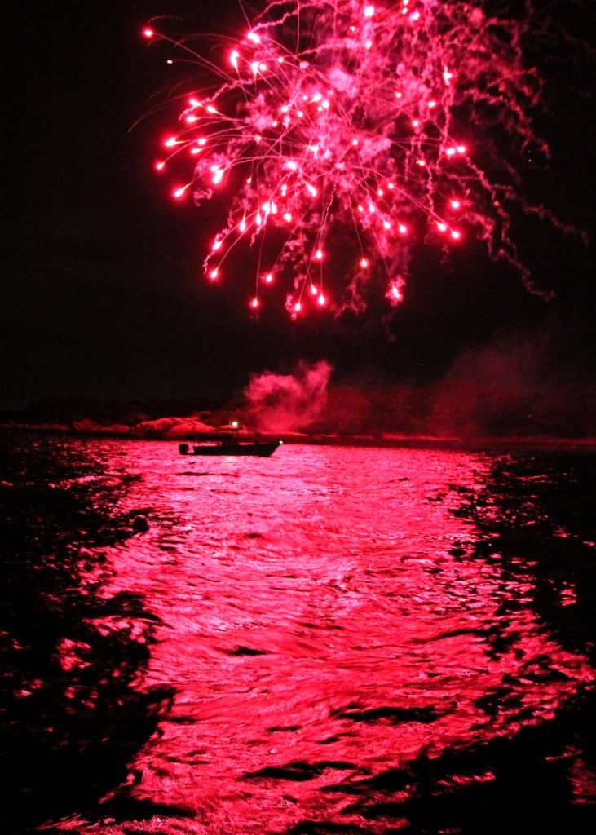
Certification Process
DIRAUX Certification (OTO)
OTO Updates AuxData
You are now a Boat Crewmember !

Slide 48
Currency Maintenance
Maintain Annual Requirements
Minimum U/W Activity
TCT
OPS Seminar (if Required)
Recertification – 3 year cycle
Core Training and Other Req’s up to date
QE Oral Exam and Currency Check Ride
QE Recommends Recertification to OTO/DIRAUX

Slide 49
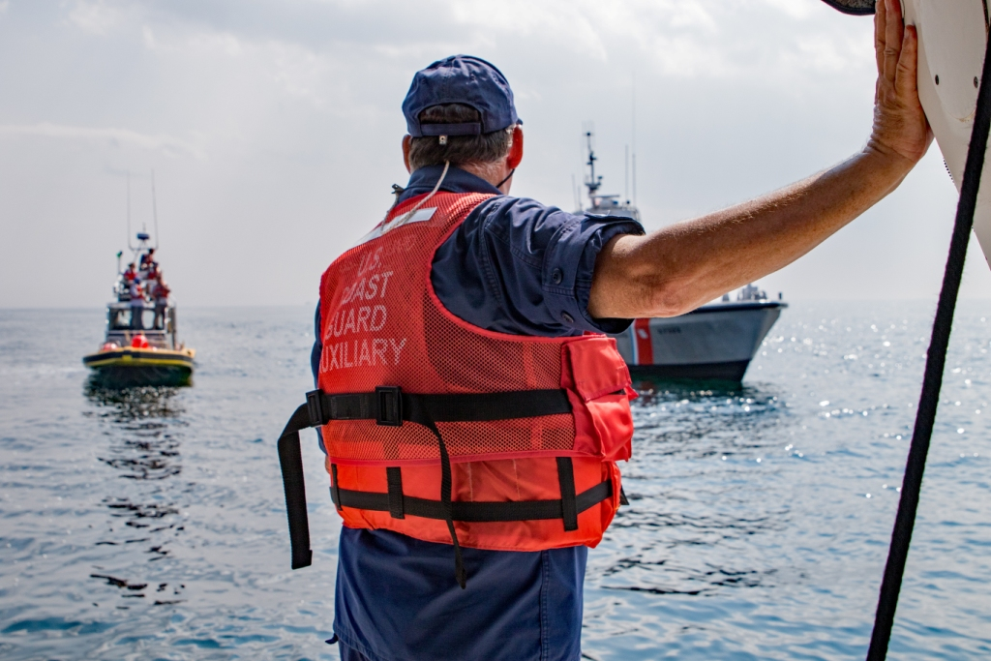
Underway Training
PPE Required
All Shoreside Tasks, Core, TCT, PE must be complete & current
Annual PPE
inspection & physical inventory

Slide 50
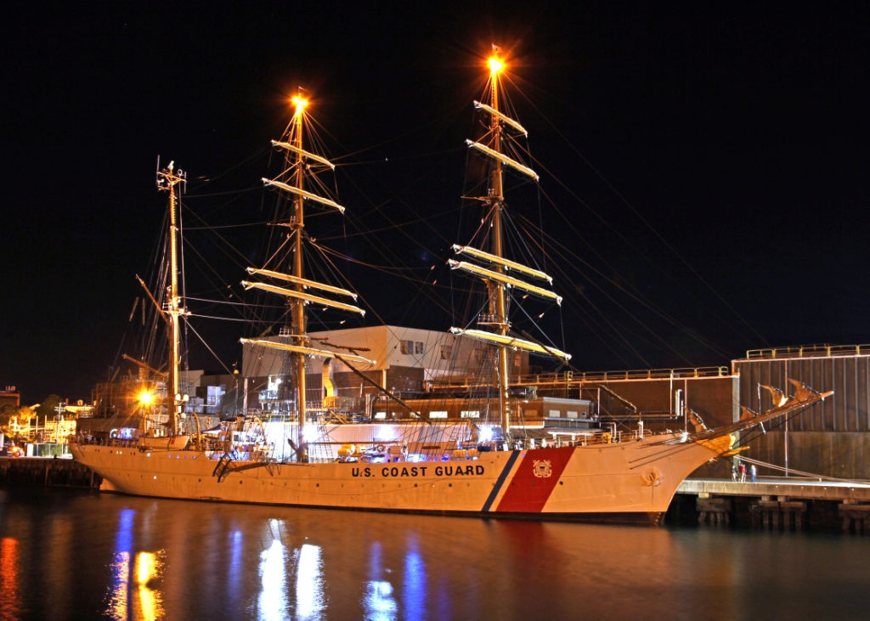
Questions ?

