Slide 1
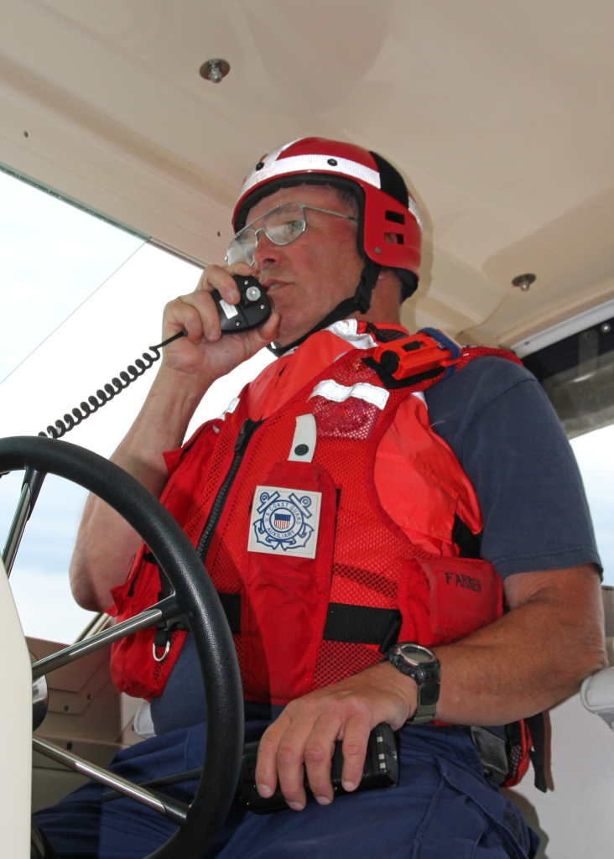
Overview of the Boat Crew Qualification Program - Crew
Prepared by WJ Bell
SO-OP Division 9, D1NR
29 JUL 2021

Slide 2
Reference
Some requirements have been superseded
Example: Risk Mgt Requirements have changed
Read the Manual

Slide 3
General Eligibility
Members with disabilities are not automatically precluded from qualifying in the Auxiliary boat crew program. Risk management evaluation should be considered concerning the safety of the individual, the crew, facility, and boating public.
all trainees, regardless of disability must successfully demonstrate the skill, ability, and endurance to perform all qualification tasks utilizing the process established in the appropriate qualification guide
Auxiliarists, who safely and successfully complete the qualification tasks by demonstrating the skill, mobility, and endurance, are considered Qualified and eligible to achieve Certification in the Boat Crew Program.

Slide 4
Physical Requirements
no specific requirements for age, weight, strength, or endurance other than demonstrating proficiency in the standard qualification tasks.

Slide 5
Physical Standards
The trainee must successfully perform each task personally,
without assistance
with little hesitation
with confidence
safely

Slide 6
Attitude/Stress
Distress is stressful
Best laid plans can change in an instant
Situation may not present as trained
Semper Gumby !

Slide 7
Risk Mgt. Crew Selection
YOU !
Coxswain
QE
Operations Officer
Elected Officers

Slide 8
Safety Policy
…It is important for coxswains to know what those capabilities and limits are, including their personal capabilities and limits, the capabilities and limits of the crew, and the capabilities and limits of the boat. Operational Risk Management (ORM) principles must be applied during all missions.

Slide 9
Safety Responsibilities
Facility Coxswain
… ensuring that required safety equipment is on board, in good condition, and properly utilized;
that all on board are wearing appropriate PPE; that a pre-underway briefing is conducted; and that patrol orders have been issued.
… the coxswain … is responsible for terminating the mission when the limits of the facility or crew may be exceeded.

Slide 10
Safety Responsibilities
Coast Guard Order Issuing Authority:
… being aware of the capabilities and limitations of Auxiliary facilities under their control,
… ensuring that patrol orders (reimbursable or non-reimbursable) are issued for all Auxiliary patrols.

Slide 11
Safety Responsibilities
Auxiliary OPS Officers & Elected Leaders:
… ensuring that members are properly trained, qualified, and certified and that facilities are properly inspected and equipped.
… they have the authority and responsibility to abort any ordered mission if they become aware of any situation pertaining to the mission or crew that may adversely affect the safety of the mission.

Slide 12
Safety Responsibilities
Everyone is responsible
All members must work as a team.
The team may be the crew members on an individual patrol facility,
Each member of each team must maintain continual situational awareness, and alert others on the team when an unsafe situation arises

Slide 13
Training Required by Law
The Commandant is required by law to train, examine, and qualify Auxiliary members before assigning them to duty
Protection of Aux Members
Protection of the public

Slide 14
Liability Protections
Auxiliary members are afforded protection against liability for property damage or loss, personal injury, disability, or death, and are protected against third-party lawsuits resulting from the performance of their duties while under orders.

Slide 15
Liability Protections
This liability protection is effective only when an Auxiliarist:
is properly qualified and assigned to duty, and
acting within the scope of assigned duties.

Slide 16
Positions
Crew Member
Coxswain
PWC Operator
AUXPAD Afloat ? (subject of another COMDINST)

Slide 17
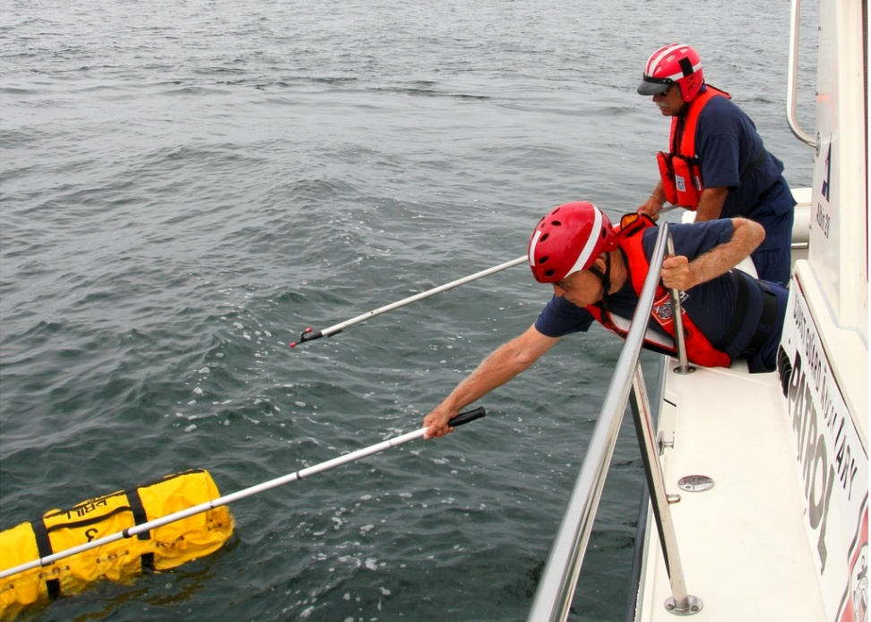
Crew Member
assists the coxswain with handling the boat and performing mission activities.

Slide 18
Coxswain
is in charge of the facility and is responsible For :
directing the safe navigation of the boat,
activities of the crew, and the performance of the missions.
Skills of a qualified coxswain include navigation, piloting, boat handling, communication, search planning, and emergency procedures.

Slide 19
Qualification Program Steps
Qualification
Certification
Currency Maintenance

Slide 20
Qualification Overview
Candidate Performs Task:
personally, without assistance.
performed with little hesitation.
with confidence.
Safely
Mentor Signs off Task
U/W Check Ride with QE

Slide 21
Qualification Examiner
Must be: Coxswain, Instructor, AUXOP* Min 20 hrs/yr U/W*
Experienced
Appointed by and Reports to DIRAUX via OTO and Chief QE (2 year appointment)
Recommends Certification to DIRAUX

Slide 22
Certification
DIRAUX is the Certification Authority

Slide 23
Currency Maintenence
Annual U/W hours
Annual Operations Seminar (if Required)
TCT & Core Training up to date
Currency Maintenance Check Ride w/ QE every three years
NavRules exam every 5 years for Coxswain

Slide 24
Important AuxData Terms
REYR – Failure to meet Annual, Triennial or other Requirements
REWK – Failure to meet Required Workshop Requirement

Slide 25
Failure to Meet Currency Tasks
Member in REYR 12/31
Member needs to complete tasks
FC or MT requests OTO to Remove REYR
OTO will check AUXDATA – Re-Certify If it’s not in AuxData it didn’t happen !

Slide 26
Failure to Meet U/W Hours
Member makes up hours as trainee
FC or MT requests OTO to remove REYR
OTO will check AUXDATA – Re-Certify
Member completes Annual Hours for current year to avoid REYR

Slide 27
Failure to Meet U/W Hours
one to four years - must complete twelve hours as a trainee to regain certification and 12 additional hours as a qualified member to maintain certification.
fail to complete the triennial check ride must complete the check ride before being recertified

Slide 28
Failure to Meet U/W Hours
Members who do not have underway hours for a period of five years or more must re-qualify by completing all required tasks for the desired position.

Slide 29
Read the Manual

Slide 30
Overview of the Boat Crew Qualification Program - Crew
Questions ?
Notes:
@ red pennants = Gale Warning - GALE WARNING: A warning of sustained surface winds, or frequent gusts, in the range of 34 knots (39 mph) to 47 knots (54 mph) inclusive, either predicted or occurring, and not directly associated with a tropical cyclone.
One red pennant = Small Craft Advisory

