Slide 1
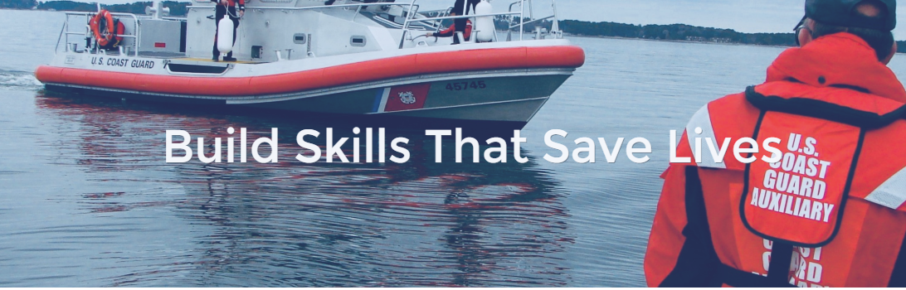
How to Set up Your own Member Page
Start at HOME page and click Members from Main Menu
Debra Hibert , ADSO-IS, D1NR
April 29, 2020

Slide 2
Once on Member Page – Click All active Members from drop down list
DHibert, ADSO-IS 4/29/2020

Slide 3
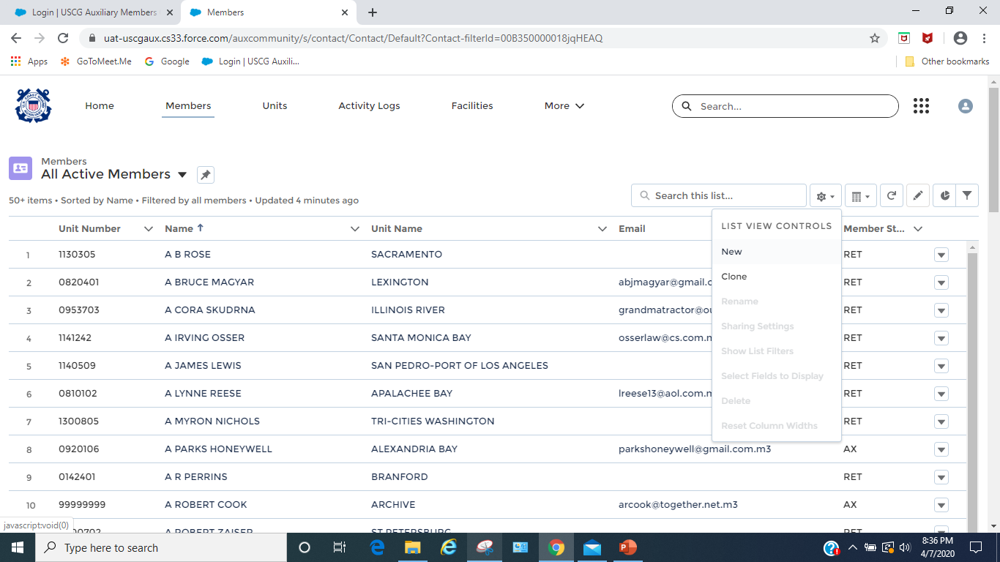
In sphere icon drop down - Click Clone
DHibert, ADSO-IS 4/29/2020

Slide 4
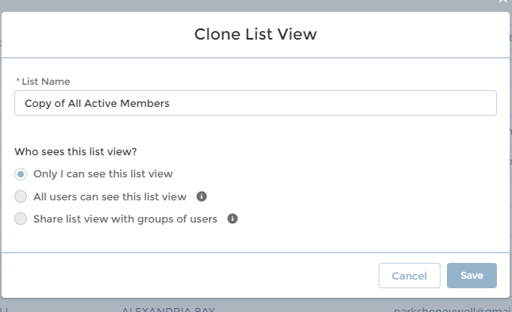
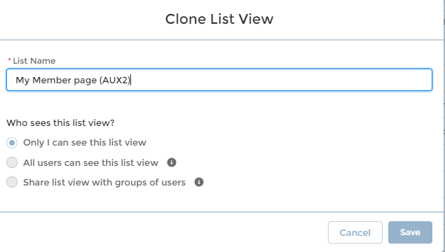
New Window pops up – change the list name to your Member page Title:
i.e. My Member page – Then CLICK SAVE
DHibert, ADSO-IS 4/29/2020

Slide 5
Next Add a filter to customize to your page or info: Click Filter Icon , Filter menu comes up
Choose field: First NAME
Choose Operator => contains
Choose Value => YOUR NAME
Click Done
Click SAVE
DHibert, ADSO-IS 4/29/2020

Slide 6
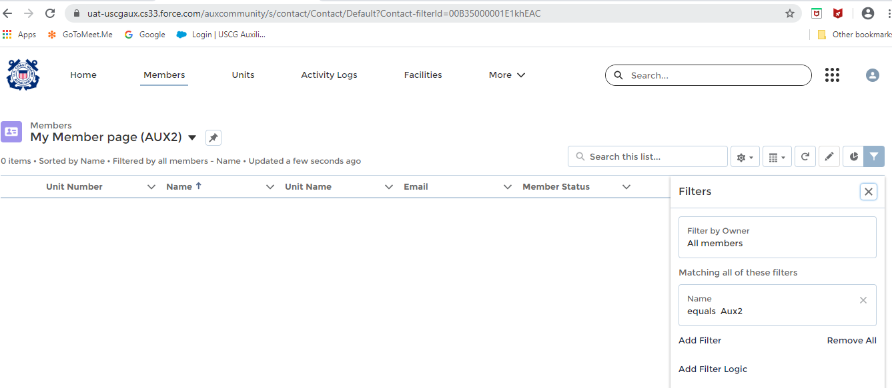
Then Click REFRESH button
DHibert, ADSO-IS 4/29/2020

Slide 7
Then PIN this page using the pin icon
DHibert, ADSO-IS 4/29/2020

Slide 8
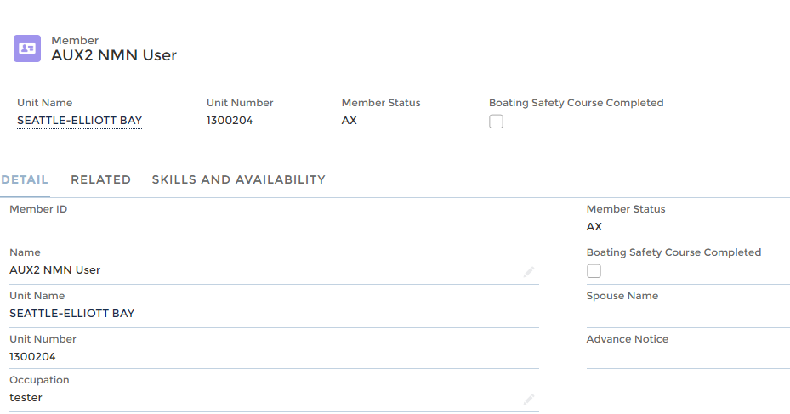
Now when you come back to the Member menu and click on it you will be brought to your page and then click on your name
You will be brought to your page with tabs of DETAIL, RELATED and SKILLS and AVAILABILITY
DHibert, ADSO-IS 4/29/2020

