Slide 1
This slide set is approved for use in D1NR.
This document was released by the DSO-PE D1NR on 19 FEB 2017

Slide 2
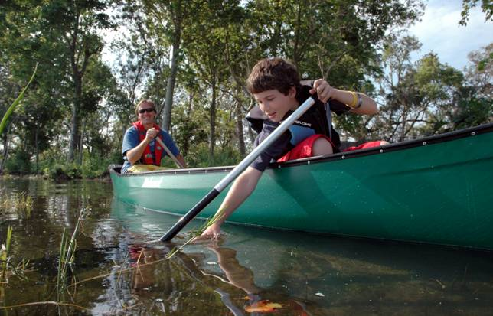
Paddle Sports Safety Canoes, Kayaks, Rafting, Paddle boards
Notes:
Instructor Notes:
Paddle sports continue to be the fastest growing segment of recreational boating, with more than 300,000 paddle crafts (canoes, kayaks and paddle boards) being sold annually.
Paddle crafts are an extremely affordable entry point to recreational boating, which is attractive to new boaters, boaters downsizing from larger boats, and those interested in exploring their waterways.
But too many people are not aware of potential dangers and do not adequately prepare
Too many paddle sport deaths have occurred in recent years.

Slide 3
Kayaker Death in Lake
Stafford, NH – November 2016
Kayak capsized in middle of lake
High winds and extreme water conditions contributed to the drowning death of a 62-year-old woman
50 mph wind gusts
2 ½ foot swells
Cold water
Emergencies can unfold in seconds
Notes:
Instructor Notes:
Here is one tragic recent example of a kayaker underestimating the wind and water conditions.

Slide 4
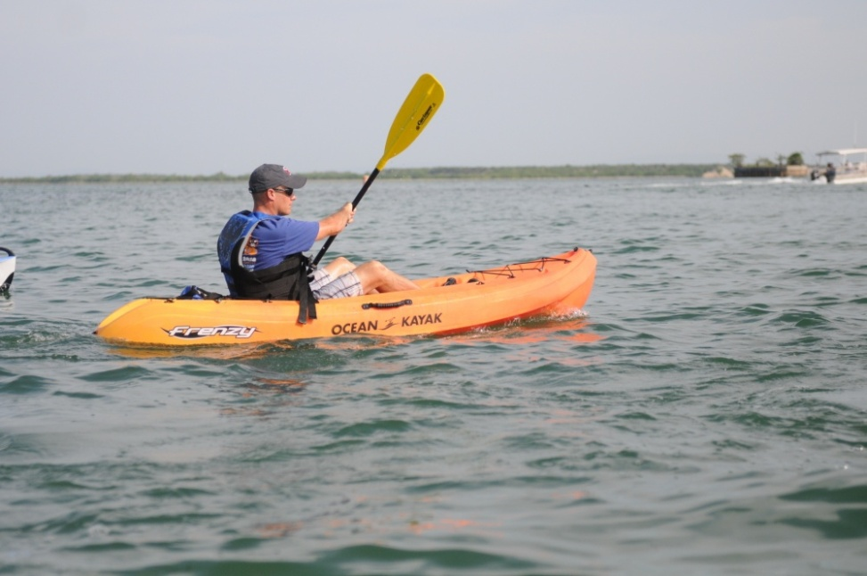
Paddle Sports Safety Canoes, Kayaks, Rafting, Paddle boards
First District Coast Guard: 28 of 49 fatalities on paddle craft in 2016
75% of fatalities could have been prevented if a life jacket was worn!
Notes:
Instructor Notes:
Note: First District CG includes ME, NH, VT, MA, RI, CT, NY, NJ.
In contrast with other boating, paddle sport fatalities have been trending higher due partially to its growth in popularity, but also because of lack of awareness of precautions that should be taken to avoid putting yourself in harm’s way.
These fatalities were typically due to not wearing a life jacket, not dressed for cold water, capsizing and falling overboard.
Coast Guard now has a special focus on paddle sport safety.

Slide 5
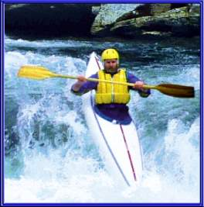
Paddle Sports Safety Top Ten Practices
Wear your lifejacket
Beware of cold water
Take an on-water course
Know the Rules of the Road
Check equipment prior for wear or failure
Notes:
Instructor Notes:
Wear Your Lifejacket - Expect to capsize and swim occasionally when paddling a canoe, kayak, SUP or raft.
2. Cold Water and Hot weather Safety - Cold water is extremely dangerous! Remember the 120 rule – if air + water temp < 120 you need a wet suit. Heat stroke can be fatal. Learn the essentials of on-the-water temperatures and first aid.
3. Take an On-Water Skills Course - whether it's a safety or skill development course, an instructor-led on-water instruction course provides the information you need for canoeing, kayaking, stand up paddleboarding, rafting and/or safety & rescue.
4. Rules of the Road – Navigation Rules apply as do security zones and distance restrictions to US Navy vessels, power plants, etc.
5. Safety Check - Check to make sure all safety gear is onboard and functional prior to heading out every time.

Slide 6
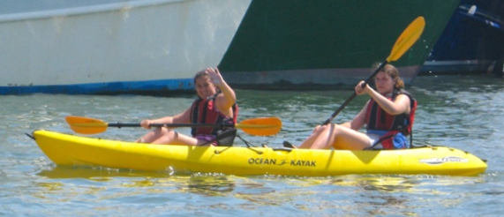
Paddle Sports Safety Top Ten Practices
Know practices, ethics, conduct
Know your limits
Learn and practice rescue skills
Learn best practices
Plan and prepare for trip in advance
Notes:
Instructor Notes:
6. Practices, Ethics and Conduct – know and obey rules; never litter; respect private property; be considerate to others on the water; never engage in lewd or inappropriate behavior; do not disturb wildlife.
7. Know Your Limits - Know your skill level and avoid weather or water conditions that exceed your skill.
8. Learn and Practice Essential Rescue Skills, e.g., how to get help; how to re-board if capsized.
9. Learn Best Practices: what to wear; essential gear; how to prepare; best safety practices on the water.
10. Trip Preparation and Planning – Know the water you are paddling. Be aware of tides and dangerous currents. Getting ready to schedule your next trip? Inform someone of your plans: could do my text or email. Better yet, file a Float Plan. This could be done using the CG APP.

Slide 7
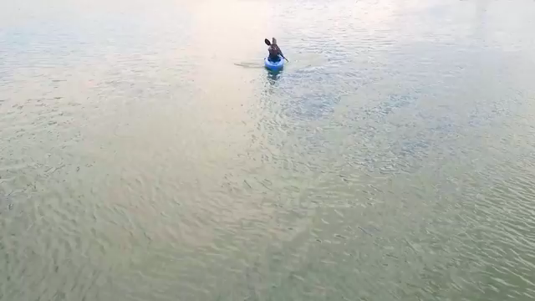
Essential Paddling Gear
Notes:
Instructor Notes:
This slide contains a video that automatically plays after the previous slide. A right arrow click will cause it to stop and move to next slide.
Mention that this is a shortened version of what is available on line at the website shown on the next slide.

Slide 8
Safer Paddling Videos at www.nasbla.org/SaferPaddling
Basic
Strokes
Life Jackets
What If I Flip
Calling for Help
What to Wear
Traffic Rules
Essential Gear
Trip Planning
Notes:
Instructor Notes:
Instructor Notes:
The video on the previous slide is a shortened version of one of eight videos available on line.
The Safer Paddling Series is a collection of highly specialized paddle sports safety videos targeting new paddlers produced and distributed through manufacturer’s channels during the 2016 paddling season. Each one runs about three minutes.
Episode 1: Lifejackets
Episode 2: What To Wear
Episode 3: Gear Essentials
Episode 4: Basic Strokes
Episode 5: Plan Your Trip
Episode 6: Traffic Rules for Paddlers
Episode 7: What If I Flip?
Episode 8: Calling For Help

Slide 9
Paddle Sports Safety Essential Gear
Wear
Lifejacket & whistle, hat/helmet, sunglasses, sunscreen, proper clothing and footwear
Bring
Spare paddle
Water & snacks
Dry bag
Compass and chart
Rescue gear
PLB
VHF radio
Bailer or bilge pump
First aid kit
Insect repellant
Tow line
Knife
Notes:
Instructor Notes:
Other equipment to consider bringing
* Wear clothing designed for weather and water conditions—visible colors!
* Use clothing and equipment (e.g., hats, sunblock, extra clothes) to reduce the risks of environmental problems such as hypothermia and sunburn
* Bring adequate food, water, and extra clothing. Fill the bottle half way so it floats and is easy to see —full may be more difficult to see due to neutral buoyancy
* Match extra gear (e.g., helmets, radios, flotation bags, spare paddles, navigation tools) to the paddler, the group, the environment and the desired activity
* Carry appropriate rescue gear and learn how to use it. This includes PLB (Personal Locator Beacon).
* Navigation lights, distress signals and sounds signals may be required. Check with your local state boating officials to find out what you need to carry with you. Every paddler should have a whistle attached to their lifejacket.
* Printed pre-underway checklist
* Pen or pencil
* Notebook/logbook
* Sponge and/or manual pump for dewatering
* Other gear needed for safe operation and self-rescue of the particular type of paddle craft: e.g., paddle float, paddle leash, spray skirt
*Bow line and/or stern line (“painter”) to tie up along a dock or ashore
* Label or Nameplate affixed to interior of vessel, identifying Owner and "if found" phone numbers
* In coastal waters, one waterproof VHF marine radio or portable VHF radio in clear plastic waterproof bag.
* Watch, (waterproof)
* Cell Phone in waterproof container as backup
* Flashlight or Headlamp
* Flotation foam or bags sufficient to permit self-rescue
* GPS
* Compass, hand-held or mounted
* Rescue throw bag (smaller size for paddle craft, 30' max recommended)
* Spare paddle/oar
* First Aid Kit
* Emergency survival blankets (2) "space blankets"
* Chart of Local Area
* Repair equipment such as extra rudder cable, spare foot peg, drain plug
* Additional rescue gear specific to your trip
Be sure to securely attach everything to your boat so nothing can float away after a capsize!

Slide 10
Paddle Sports Safety Other Safety Rules
Never paddle alone
Be a swimmer
Inform someone of your plans
Learn to recognize and avoid potential hazards
For low light, bring light/signal
Add flotation to kayaks
Get Vessel Safety Check
Notes:
Instructor Notes:
Inform someone of your plans: could do my text or email. Better yet, file a Float Plan. This could be done using the CG APP.
Add flotation to kayaks: Many kayaks have inadequate flotation to handle capsizing and re-entering. Air filled bladders (“float bags”) should be placed in the bow and especially the stern.
Vessel Safety Checks are done by the Auxiliary and the Power Squadron.

Slide 11
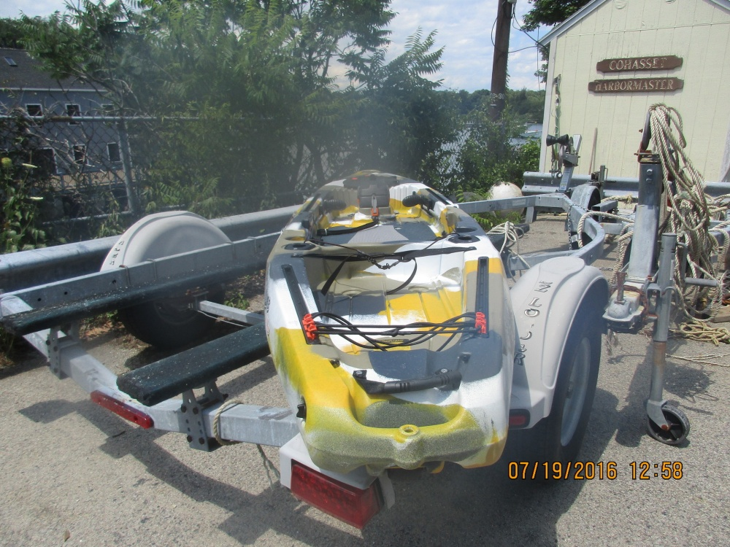
Coast Guard Searches for Possible Missing Kayaker*
Cohasset, MA – July 2016
Unmarked kayak was found adrift
Unsure whether people were in distress
Extensive search launched
* From U. S. Coast Guard Digital Newsroom
Notes:
Instructor Notes:
Discovery of an adrift paddle craft poses a difficult problem to the Coast Guard:
Is someone missing?
Should a search be initiated?
In this case of a kayak found adrift, an extensive search was launched by sea and air. Expensive:
- Air search costs $11K/hour
- Sea search costs $3K/hour
The owner recognized his kayak from the news reports and recovered his boat from the CG station. Owner said the kayak blew off the dock.

Slide 12
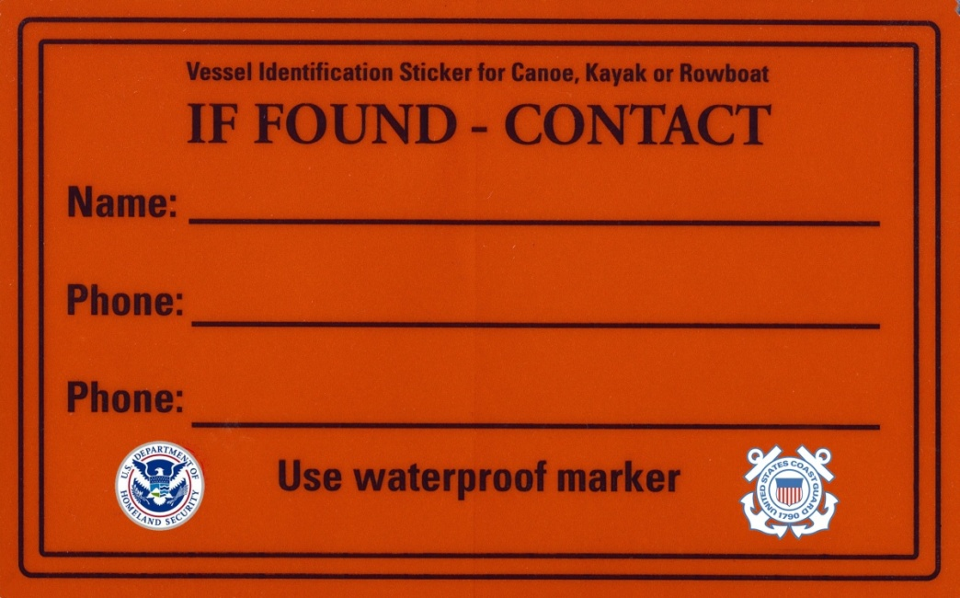
Canoeing, Kayaking, …
Emergency or lost boat?
Fill out sticker and attach to your paddle craft
Canoes, kayaks, rowboats, rafts, paddleboards
Information on this sticker could:
Lead to your rescue
Return your property to you
Save Coast Guard time and costs
Notes:
Instructor Notes
ASK if anyone needs the decal for their paddle craft, and issue them accordingly.
Benefits of Having an If Found Sticker.
You get your boat back,
Save tax payer money (CG Boat = $3000 per hour, CG Helo = $11,000 per hour, plus state and local search resources),
Prevents CG and other resources from unnecessary searches which could take them away from conducting cases that are not false alarms.
Allows CG and other resources to quickly determine the urgency of response required when a paddle craft is found with a If Found sticker.

Slide 13
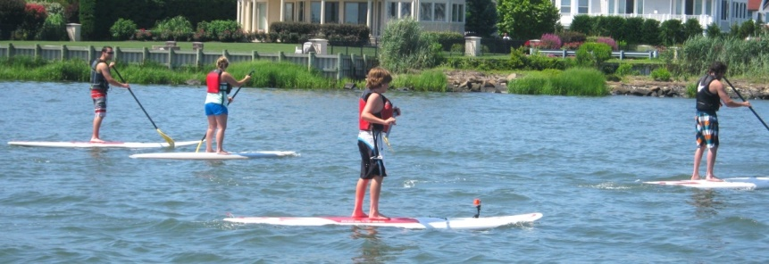
Stand Up Paddleboards
When beyond swimming, surfing, or bathing area, paddleboard is considered a “vessel”
Generally, wearing a life jacket and leash beneficial
Life jacket in surf could be dangerous
Leash in swift water could be hazardous
Notes:
Instructor Notes:
(The following notes are excerpted from the CG Proceedings Fall-Winter 2016 - RBS.)
When it is beyond the narrow limits of a swimming, surfing, or bathing area, a paddleboard is considered a “vessel” under 46 U.S.C. § 2101, and is subject to USCG regulations.
Generally wearing a life jacket and an appropriate leash would be beneficial. But it can actually be dangerous to wear a life jacket in surf. If you can swim (and I sincerely hope that those who paddleboard can swim), and if you’re actively surfing in the ocean, then wearing a life jacket would not allow you to dive underneath waves once you’ve fallen off your board. In addition, a life jacket would keep your head on the surface — right next to the board’s sharp fins and hard rails.
Wearing a leash in moving water or a swift-flowing tidal river could be extremely hazardous. It is a widely accepted practice that SUPs use coiled leashes on lakes and straight leashes in the ocean. A more challenging scenario is presented in tidal and inland rivers with swift-moving water: Imagine falling off your board. The board goes around a dock piling on one side while you go around the other, or the leash snags on a branch along a river. Wearing a leash in those situations could be extremely
dangerous.
Local, state and federal laws in this area are a work in progress.

Slide 14
Federal Regs on Paddle Sports
Wearable life jacket for each person
Whistle
Visual Distress Signal if on coastal waters at night
White light at night and periods of restricted visibility
Hull Identification Numbers – canoes and kayaks
Abide with Pollution Regulations
Follow Navigation Rules
Notes:
Instructor Notes:
PFD - 33 CFR 175.11: One wearable life jacket for each person on board
Inflatable OK if 16 years of age or older
Throwable not required unless 16’ or longer and NOT a kayak or canoe
Must be worn by children under 13 years of age while underway
For SUPs in surf area, life jacket should not be worn
Sound - CFR 83.33 and Navigation Rule 33(b): A vessel of less than 12 meters must have some means of making an efficient sound signal.
Visual Distress Signal (VDS) - 33 CFR 175.101. On coastal waters and high seas paddle craft must carry suitable VDS for night use between sunset and sunrise.
Lights - Navigation Rule 25 (d)(ii): A vessel under oars shall have an electric torch or lighted lantern showing a white light which shall be exhibited in sufficient time to prevent collision.
Hull Identification Numbers (HIN) - 33 CFR 181: HIN are required for canoes and kayaks. SUPs are exempt from HIN requirements.
Must abide with Pollution Regulations prohibiting depositing refuge of any kind into US waters.
Must abide by the Navigation Rules.

Slide 15
Additional State Regs on Paddle Sports
Life jackets must be worn:
STATE | VESSEL TYPE | START | END
CT | Manually propelled | October 1 | May 31
MA | Canoe, kayak | September 15 | May 15
NY | Pleasure | November 1 | May 1
VT | Sailboard | January 1 | December 31
Notes:
Instructor Notes:
Connecticut
Life jackets must be worn by anyone in a manually propelled vessel from October 1 through May 31
Massachusetts
Life jackets must be worn by persons on board a canoe or kayak from September 15 to May 15
New York
Life jackets must be worn on pleasure vessels between November 1 and May 1
Vermont
Persons under 16 years of age must wear a PFD while on board a sailboard

Slide 16
Additional State Regs on Paddle Sports
Maine
Paddleboards must have visual distress signals on territorial waters between sunset and sunrise
Exempt from life jacket requirements are licensed canoes owned by summer camps
Vermont
Persons under 16 years of age must wear a PFD while on board a sailboard
Notes:
Instructor Notes:
Maine:
Paddleboards must have visual distress signals when used on territorial waters between sunset and sunrise
Exempt from life jacket requirements are licensed canoes owned by a summer camp and used for teaching by a camp counselor at least 18 years old while within 500 feet of the camp’s shoreline
Vermont:
Persons under 16 years of age must wear a PFD while on board a sailboard

Slide 17
AGES THAT CHILDREN MUST WEAR LIFE JACKETS
Federal | Less than 13 years of age
CT, NJ, RI | Less than 13 years of age
MA, NH, NY, VT | Less than 12 years of age
ME | Less than 11 years of age
Notes:
Instructor Notes:
Note: State regulations take precedence over Federal regulations.

Slide 18
Key Takeaways
Wear your life jacket!
Pay attention to what is happening around you!
Be visible!
Communicate!
Notes:
Wear your life jacket!
Pay attention to what is happening around you! (situational awareness)
Be visible! (clothing and equipment
Communicate! With each other in your group and with first responders as needed

Slide 19
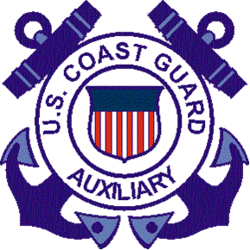
QUESTIONS?

Slide 20
Following slide is intended for Introductory brief. It is included here for convenience.

Slide 21
Coast Guard Rescues Kayaker Portsmouth, NH – January 2017
34 year old man capsized in mouth of River
Winds 15 kts with 25 kt gusts
43° water
Man was
hypothermic
not wearing a life jacket or wet/dry suit
VERY LUCKY HE DID NOT DIE
Notes:
Instructor Notes
From Coast Guard’s Survivor Debrief Form:
(Kayaker) launched from the beach … at approximately 1100. After approximately 10 minutes of paddling into the waves his kayak was flipped by a wave. Mr. XXXX was able to re-right himself with his paddles before immediately being rolled over by another wave. This wave pushed him out of the kayak skirt. He surfaced and righted the kayak before trying to climb in. After realizing he was unable to climb back into the kayak and wasn’t able to swim to shore he flipped the kayak upside down and shoved his arms through the skirt, wedging himself in the kayak. Using his legs he kicked and when he felt dizzy he tipped the kayak to let fresh air in. He did hear a boat approaching, hoped it was for him and with his last strength he raised his hand before passing out. There was a life jacket in his forward bilge that he was not able to get to when he flipped over.

Slide 22
REFERENCES
www.nasbla.org/SaferPaddling
BoatingCourses.us
www.AmericanCanoe.org
Notes:
Instructor Notes
Rather than showing this slide, provide each student a copy of the Reverence Sheet.

